Slide 1
IOT and PLC based smart home system with PV inverter and blockchain based energy trading.
Principal Investigator
Ms. Athira Prasad
Assistant Professor
Department of Electronics and Communications
Mar Athanasius College of Engineering,
Kothamangalam
Student investigators
1. Mathew Varghese
2. Ameer Fayiz
7th Semester
Department of Electronics and Communication,
Engineering
Mar Athanasius College of Engineering,
Kothamangalam

Slide 2
PROBLEM DEFINITION
IOT systems employ WiFi technology, which cause spectrum crowding in the 2.4GHz free band
Potential health hazards of wifi in residential areas are yet to be researched
Expensive routers and repeaters required to cover large houses and public areas like galleries.
Current systems can be manipulated by hackers due to lack of proper security
CURRENT DEVELOPMENT IN THIS AREA
People are moving towards decentralised energy production and are in dire need of secure and efficient ways to transfer electricity

Slide 3
OUR SOLUTION
Use wired communication
Use online UPS to
Use powerline for communication so as to reduce wires
Implement blockchain based energy trading to provide a secure energy trading marketplace
Collect usage data so that it can be used to predict the data usage
Add a solar panel to this system so that users can generate electricity, even if it doesnot meet their peak demand

Slide 4
OBJECTIVES
Broad Objectives
Design and implement an IOT based smart home system with a PV inverter which communicates using PLC and implement blockchain based energy trading
Precise Objectives
Develop an ecosystem for implementing PLC on IOT systems and enable energy trading in a secure way using blockchain technology. Also we aim to encourage the use of solar cells by integrating a solar inverter along with the PLC control system and making it open source.

Slide 5
APPLICATIONS
Decentralised energy production and secure energy trading using blockchain encourages the use of green energy
Less dependency on centralized power generation
Optimise power usage by predictive analysis and automation
Control and monitor the status of devices via internet or mobile application
Provide analytics on the energy usage pattern of households.
Open source IOT based smart pv inverter system encourages further development in this area

Slide 6
ABSTRACT
We eliminate the need for this broad wifi coverage for smart homes by communicating control signals over the powerline itself. The system consist of a solar inverter, a main PLC control box and a control box at every switchboard.The control unit is provided with internet access either via lan cable or via wifi modem. All the switchboards and appliances will be connected to the control unit via existing powerline itself. We implement an online UPS system with lead acid battery for the PV system and the energy usage pattern of all the connected homes can be recorded and analyzed.
The main control box is connected to the internet which enables the whole system to be communicated remotely via a website or mobile app. This also enables us to do the analytics on the usage pattern of households and energy usage prediction. We also design an online solar ups which is able to do energy trading with the help of a blockchain based system. Solar energy is gaining popularity these days, but the marketplace for distributed generation of energy is weak. The energy transfer data can be tampered with. We curb this idea by implementing a blockchain based system. It’s based on a distributed ledger. We also use the idea of smart contracts to carry out energy billing.
The inverter market is dominated by a few individuals and majority of the companies buy rights from these proven designers and this increases the cost of them. We aim to make it open source so that engineering community can work on it and thus benefit from the knowledge generated by doing this project.

Slide 7
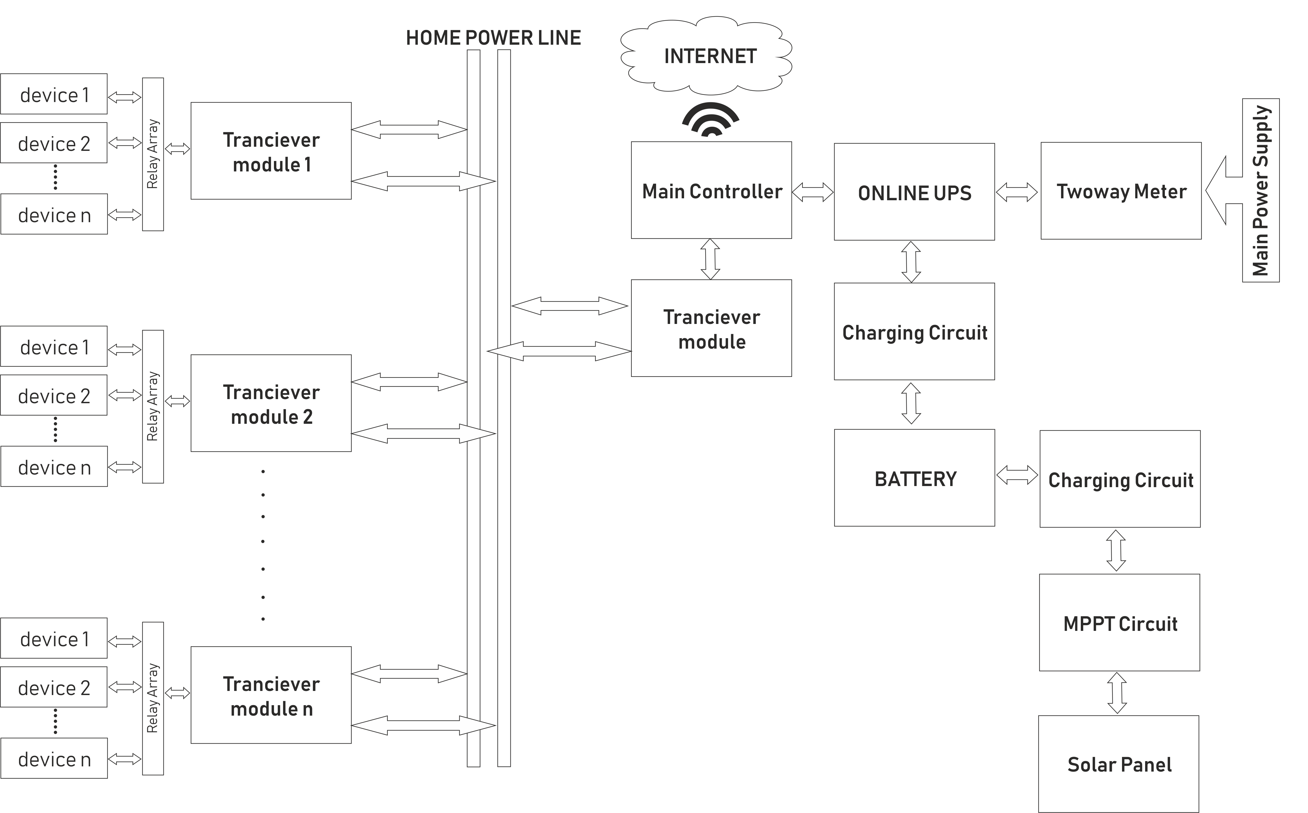
PROPOSED METHODOLOGY
HARDWARE BLOCK DIAGRAM

Slide 8
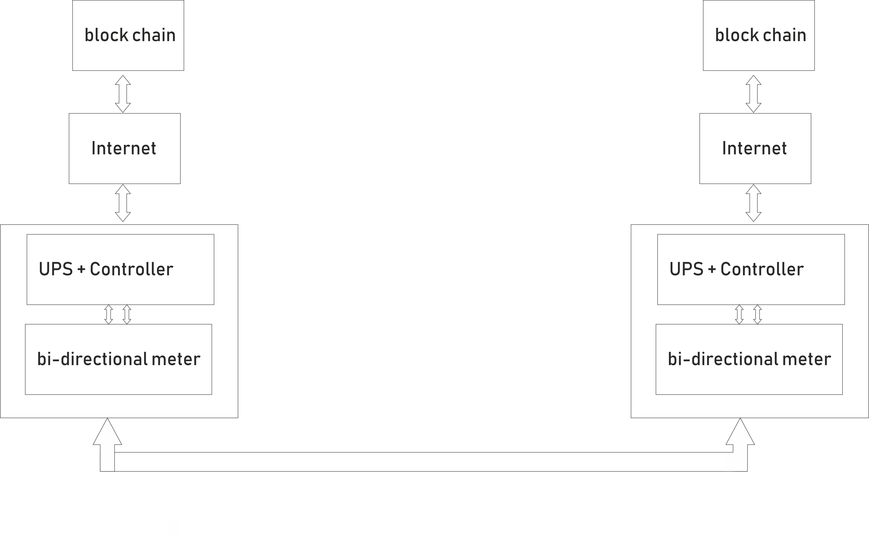
PROPOSED METHODOLOGY
Communication topology

Slide 9
MAX 2992
Optimized to Operate with the MAX2990 PLC Baseband(10kHz to 490kHz)
10-Bit ADC for Rx Path
Variable Sampling Rate Up to 1.2Msps
Built-In 60dB Dynamic Range AGC and DC Offset Cancellation
Single 3.3V Power Supply
Uses OFDM (orthogonal frequency division multiplexing)

Slide 10
SCHEDULE
November 2018- Complete the product concept and acquire the required components.Develop the sinewave inverter and online UPS
December 2018- Complete the solar MPPT and interface with the online UPS
January 2019- Complete the powerline communication system with noise rejection capabilities(which is a tedious task)
February 2019- Complete the Software part using lattepanda and and make the code available online
March 2019- Develop an online marketplace for energy trading based on blockchain and implement energy coins as the medium of energy exchange(much like bitcoins)
End of March 2019- Develop the analytic part of the project and implement the energy prediction and load handling mechanism(least priority)

Slide 11
BUDGET ESTIMATE
Control Board
Raspberry pi |  |  | 3200
passive components |  |  | 2000
PCB Fabrication |  |  | 2000
Power Supply |  |  | 500
Wifi modem |  |  | 1200
LAN cable |  |  | 50
Relays |  |  | 500
OLED Display |  |  | 800
PLC Communication System
PLC IC | MAX2992 | 20nos | 1000
PCB fabrication |  |  | 2000
Passive components |  |  | 1000
Relays |  |  | 300
Online UPS
Mosfets, Relays, Triacs |  |  | 2000
Transformers |  |  | 3000
DSP based sinewave generator |  |  | 3000
Switching IC |  |  | 400
Batery Charger
Components |  |  | 1000

Slide 12
BUDGET ESTIMATE
Solar
Solar Panel | 100w 12V |  | 3000
Battery | 36Ah |  | 3300
Connecting wires |  |  | 1000
Consumable
3d printing |  |  | 4000
Laser cutting |  |  | 2000
PCB milling |  |  | 1500
Connectors |  |  | 3000
Wires |  |  | 500
MCB |  |  | 300
2 way meter |  |  | 4000
Others
research literature
travel |  |  | 500
Contingency |  |  | 1000

Slide 13
Total amount
Total amount Rs 46950

Slide 14
FACILITIES REQUIRED
LAB Facilities – FAB LAB
Access to DSO
3-D Printing facilities
PCB milling facilities
All relevant softwares including altium, fusion 360, simplify3d…

Slide 15
REFERENCES
https://ieeexplore.ieee.org/document/1343222
https://en.wikipedia.org/wiki/Blockchain
https://www.mckinsey.com/~/media/mckinsey/dotcom/client_service/risk/working%20papers/47_energy_trading.ashx
https://wiki.opensourceecology.org/wiki/Inverter

Slide 16
Thank You

